Slide 1
Decision Trees
Tim Smith, PhD

Slide 2
Introduction
Used for both classification and regression
Performs well in various contexts (including non-linear relationships)
Doesn’t require much technical knowledge
Easily interpreted (WHITE BOX)
Creates rules

Slide 3
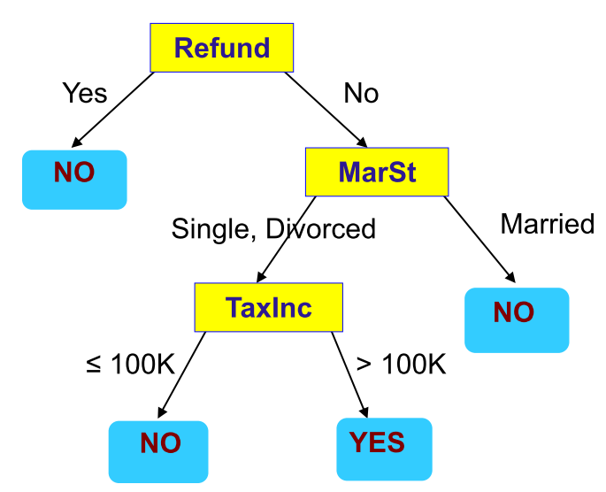
Decision Tree
Supervised Learning Model
Predictors/features/attributes as input
Predicted Output/Outcome can be checked with known result
Flowchart like Tree structure
Two types of Decision Tree:
Classification Tree (outcome is classification) ← this is our focus in this course
Regression Tree (outcome is continuous)
Root Node
Internal Nodes
Leaf Nodes

Slide 4
Decision Tree
Consists of…
Nodes and Branches
Outcomes and Predictors
Predictors
Outcomes

Slide 5
Decision Tree
Root Node
Internal Nodes
Leaf Nodes

Slide 6
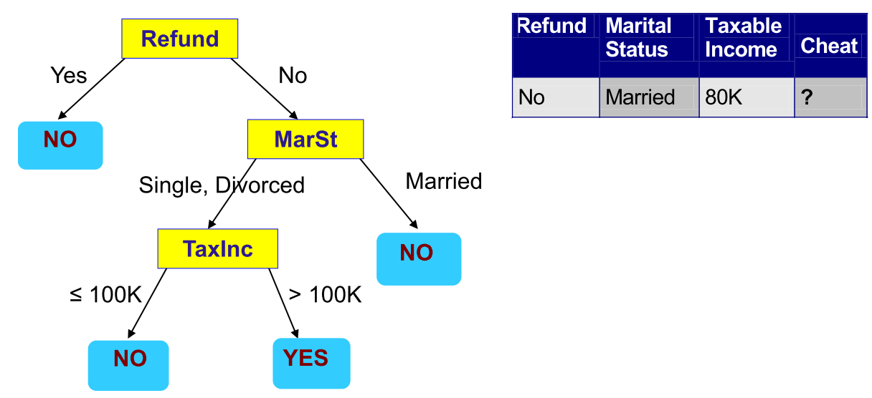
How are decision trees used for classiﬁcation?
whether a tax filer has cheated in his/her taxes

Slide 7
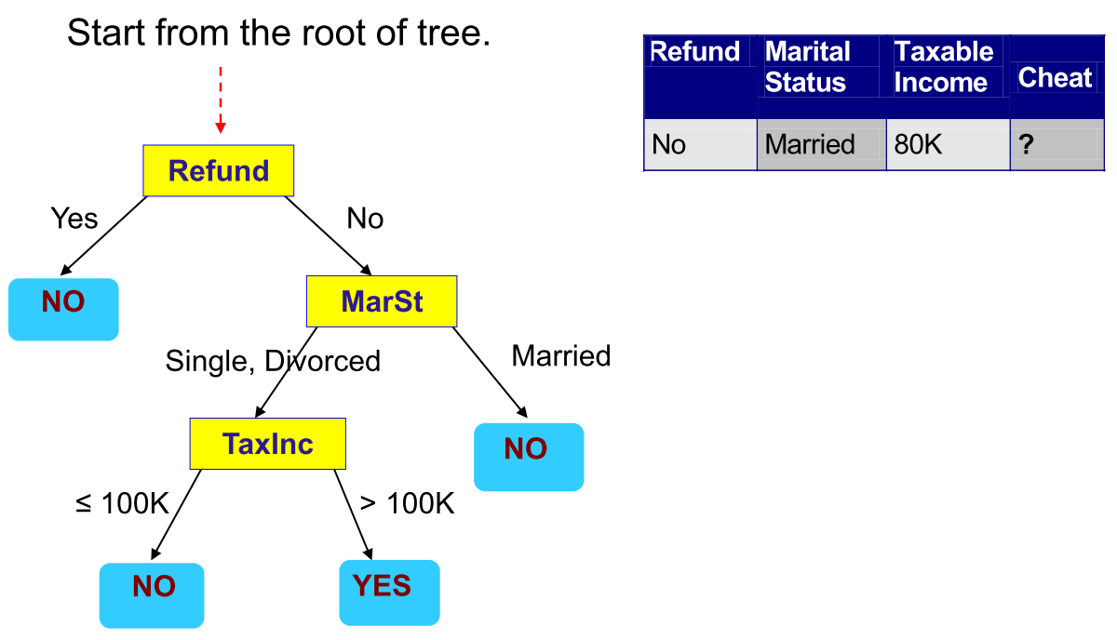
How to Use the Decision Tree?

Slide 8
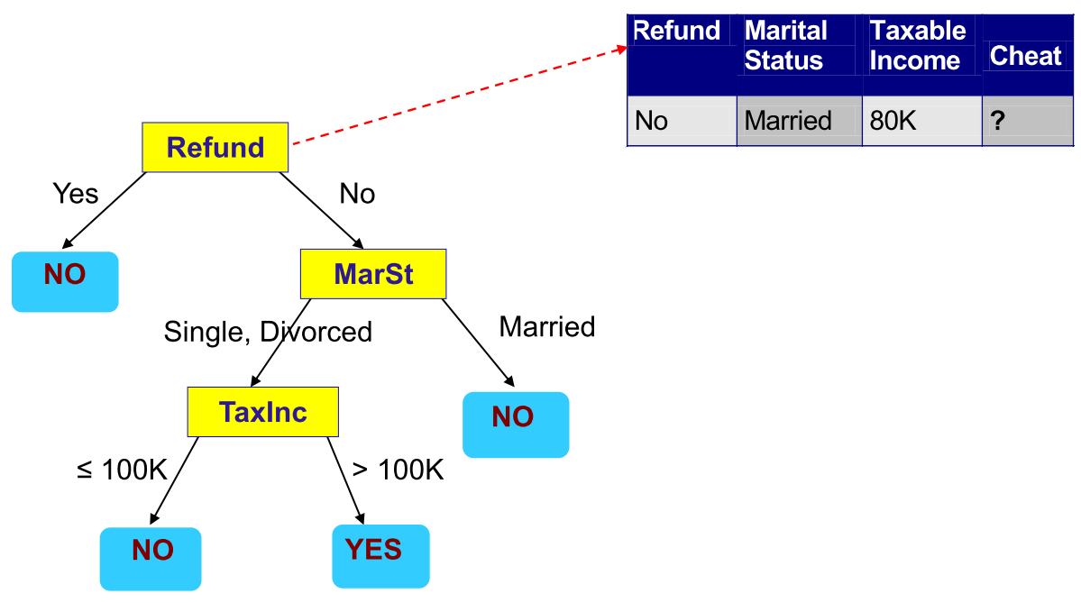
How to Use the Decision Tree?

Slide 9
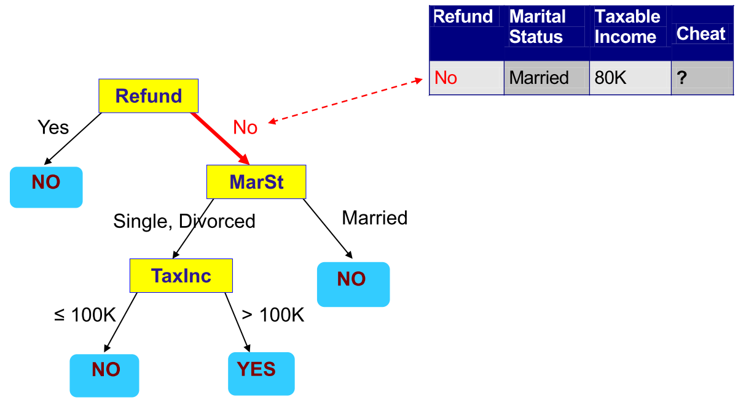
How to Use the Decision Tree?

Slide 10
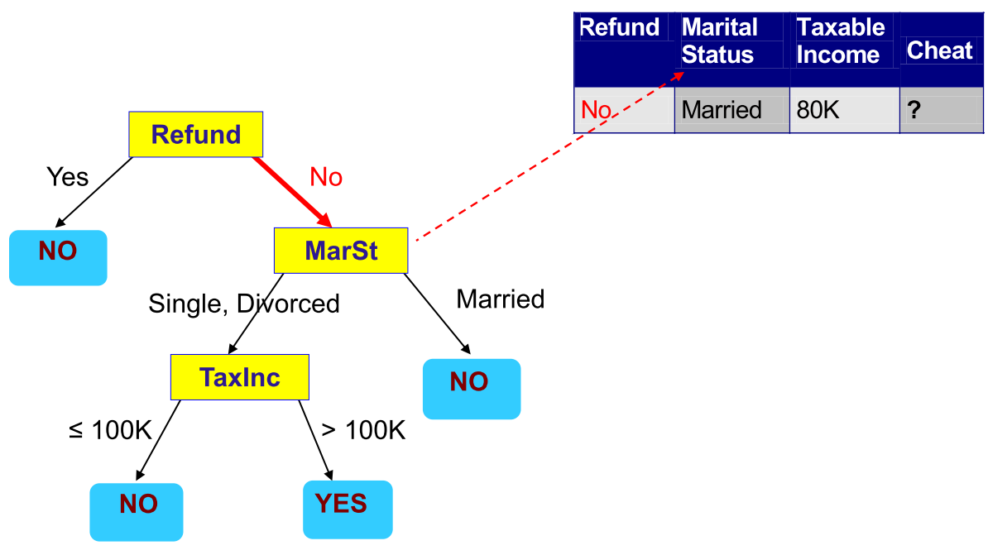
How to Use the Decision Tree?

Slide 11
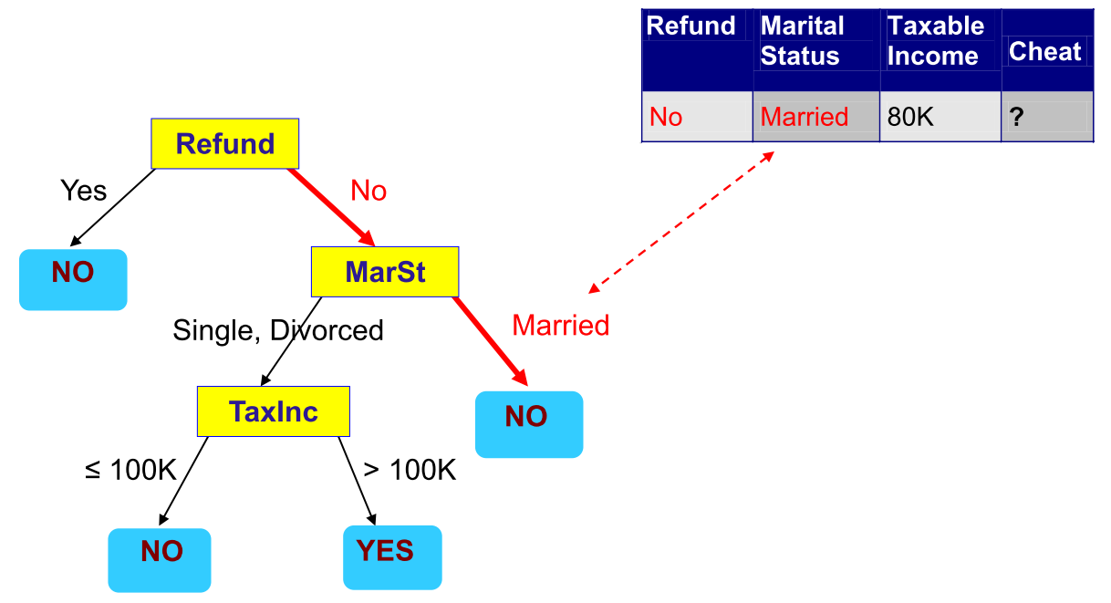
How to Use the Decision Tree?

Slide 12
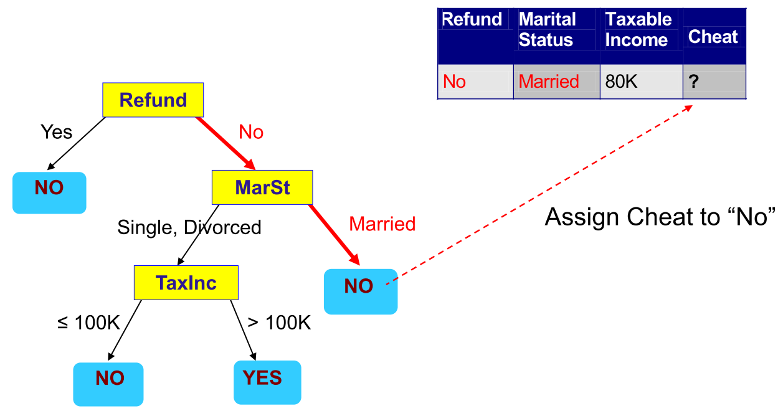
How to Use the Decision Tree?

Slide 13

Question
No
Single
123k
?

Slide 14
How to create/build decision tree
Top-down recursive partitioning
Select feature for first (root) node
Split given node into branches
Continue until no features left to use a node OR we have perfect fit

Slide 15
Building tree
How do we split a feature?
For Categorical predictor
binary – split to two branch
multiple classes – split to number of distinct classes
For continuous predictor
Binary split – optimal value
Multiple way split - binning

Slide 16
Building tree
Which order of features to split with?
Different orders of splitting will create different trees.
We’re finding the best fitting tree, so we test which node split will be better than the others.

Slide 17
Information gain as means of selecting nodes
Input Data
Input Data
More information gained
Refund Received is a “better rule
Refund Received
✓
Marital Status
Rule
Rule
Information Gain
Yes
No
Yes
No

Slide 18
How we quantify information gain?
Measure Entropy:
Higher entropy means more disorder
Lower entropy means less disorder
Measure Purity/Homogeneity
Higher purity/homogeneity means more order
Lower purity/homogeneity means less order
More disorder = more information
Less disorder = less information
If we move from more disorder to less disorder – we have extracted information

Slide 19
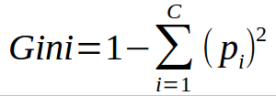
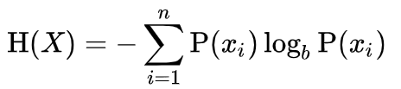
Two common measures
Gini Index – measure of homogeneity (sameness)
Entropy – another measure the accomplishes the same task
i = feature
c = # of features
i = feature
n = # of features
b = 2 (bits) or e (nats) or 10 (bans)
… use base 2
https://web.archive.org/web/19980715013250/http://cm.bell-labs.com/cm/ms/what/shannonday/shannon1948.pdf

Slide 20
Using Gini Index
Input Data
1-(3/8)²-(5/8)²= 0.46875
Marital Status
Rule
Information gain = 0.46875-0.27778 = 0.19097
Yes
No
(2/8)*0+(6/8)*0.27778=0.27778
1-(2/2)²-(0/2)²= 0
1-(1/6)²-(5/6)²= 0.27778

Slide 21
Using Gini Index
Input Data
1-(3/8)²-(5/8)²= 0.46875
Refund
Rule
Information gain = 0.46875-0 = 0.46875
Yes
No
(3/8)*0+(5/8)*0=0
1-(3/3)²-(0/3)²= 0
1-(0/5)²-(5/5)²= 0

Slide 22
Select node with greatest gain
Input Data
Input Data
Homogeneity Gain
Homogeneity Gain
0.19097
0.46875
Marital Status
Rule
Refund Received
Rule
Yes
No
Yes
No
Notes:
0.19097

Slide 23
Two common measures
Gini Index – measure of homogeneity (sameness)
Entropy – another measure the accomplishes the same task
i = feature
c = # of features
i = feature
n = # of features
b = number of branches

Slide 24
Using Entropy Loss
Input Data
-(3/8)log₂(3/8) - (5/8) log₂(5/8) = 0.954434
Refund Received
Rule
Information gain = 0.954434-0.650022 = 0.304412
Yes
No
(2/8)*0+(6/8)*0.650022=0.650022
=-(2/2)*log2(2/2) = 0
-(1/6)log₂(1/6)-(5/6)log₂(5/6) =0.650022

Slide 25
Using Entropy Loss
Input Data
-(3/8)log₂(3/8) - (5/8) log₂(5/8) = 0.954434
Refund Received
Rule
Information gain = 0.954434-0.0 = 0.954434
Yes
No
(2/8)*0+(6/8)*0.0=0
-(3/3)*log2(3/3) = 0
-(5/5)log₂(5/5) =0

Slide 26
Select node with greatest Entropy loss
Input Data
Input Data
Entropy loss
Entropy loss
0.304412
0.9554434
Marital Status
Rule
Refund Received
Rule
Yes
No
Yes
No
Notes:
0.19097

Slide 27
“Recursive” Keep going until we either get a perfect fit, or we run out of features
Input Data
Feature 1 Rule
Rule
Yes
No
Feature 2 Rule
Yes
No

Slide 28
Why use Decision Tree?
Pro
Handles multiple features
Handles multiple classifications (beyond binary)
Simple, easy to interpret the model
Acceptable/good performance
Cons
Tends to “overfit”
Solution: “pruning”
Use other methods: Random Forest, Boosted Trees (next week)
Greedy algorithm – chooses best fit without looking ahead (for instance choosing a suboptimal split could yield better results in later splits)
Can be unstable – small variations in predictive values can result in very different trees.
We will explore solutions to this next week

Slide 29
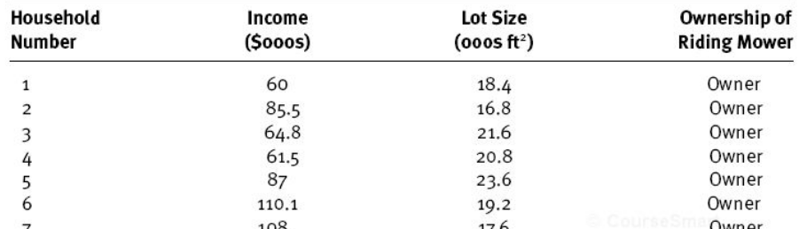
Classification Task – Example2
Example: (Imagine this is the TRAIN set)
Two predictors
(two dimensions)
Target variable
(12 owners;
12 non-owners)

Slide 30
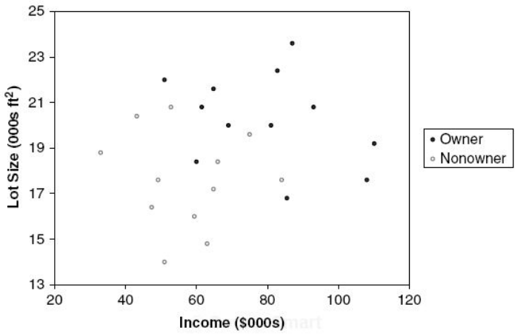
Classification Task - Example
Step 1: Create a scatterplot

Slide 31
Classification Task - Example
Step 2: Draw a vertical or horizontal line to increase the "purity" (or homogeneity) of each resulting space
Owners: 12
Non-owners: 12
Lot size
≤19
>19
Owners: 3
Non-owners: 9
Owners: 9
Non-owners: 3

Slide 32
Classification Task - Example
If you stop here: use the "majority" rule
Owners: 12
Non-owners: 12
Owners: 12
Non-owners: 12
Lot size
Lot size
≤19
>19
≤19
>19
Owners: 3
Non-owners: 9
Owners: 9
Non-owners: 3
NON-OWNER
OWNER
Which observations are misclassified?
What is the accuracy?

Slide 33
Classification Task - Example
Step 3: Draw another vertical or horizontal line to increase the "purity" (or homogeneity)
Owners: 12
Non-owners: 12
Lot size
≤19
>19
Owners: 3
Non-owners: 9
Owners: 9
Non-owners: 3
Income
≤84.75
>84.75
Owners: 1
Non-owners: 9
Owners: 2
Non-owners: 0

Slide 34
Classification Task - Example
If you stop here: use the "majority" rule
Owners: 12
Non-owners: 12
Owners: 12
Non-owners: 12
Lot size
Lot size
≤19
>19
≤19
>19
Owners: 3
Non-owners: 9
Owners: 9
Non-owners: 3
Owners: 3
Non-owners: 9
OWNER
Income
Income
≤84.75
>84.75
≤84.75
>84.75
Owners: 1
Non-owners: 9
Owners: 2
Non-owners: 0
NON-OWNER
OWNER

Slide 35
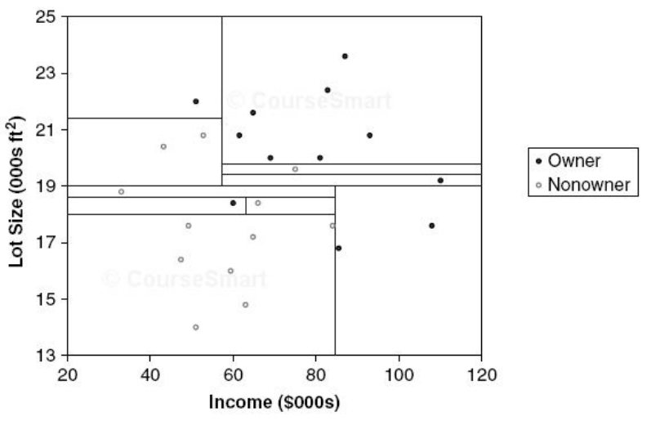
Classification Task - Example
Step 4: Continue until each resulting space is homogeneous
No cell has any "impurity"
What is the risk of eliminating all impurities?

Slide 36
Recursive Partitioning (CART)
How does the algorithm identify the split points:
Variable 1
(Income)
Variable 2
(Lot size)
Variable 3
(…)
Try all splits
Try all splits
Find the reduction in "impurity" after each split
Find the reduction in "impurity" after each split
When does it stop:
Either: hit the max depth
Or: there is no improvement in reducing impurity
Rank the results
repeat
Select the best

Slide 37
Recursive Partitioning (CART)
Scikit uses modified CART
CART is a greedy algorithm
Creates a split and moves on
Doesn’t go back to the previous split to see if it would lead to the lowest impurity
It may not converge on the optimal solution (but “reasonably” close to it)

Slide 38
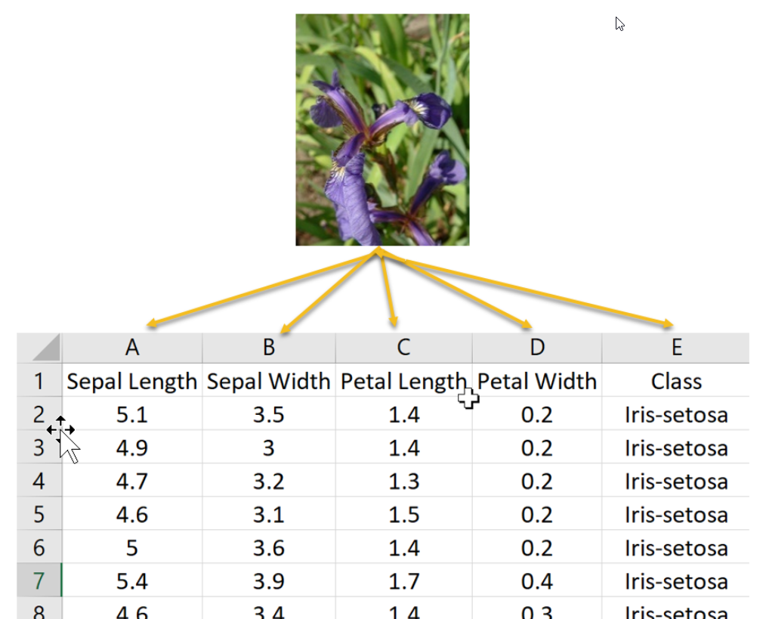
Tree Structure – SciKit version
Iris data set: (multiclass)
Source: oreilly.com

Slide 39
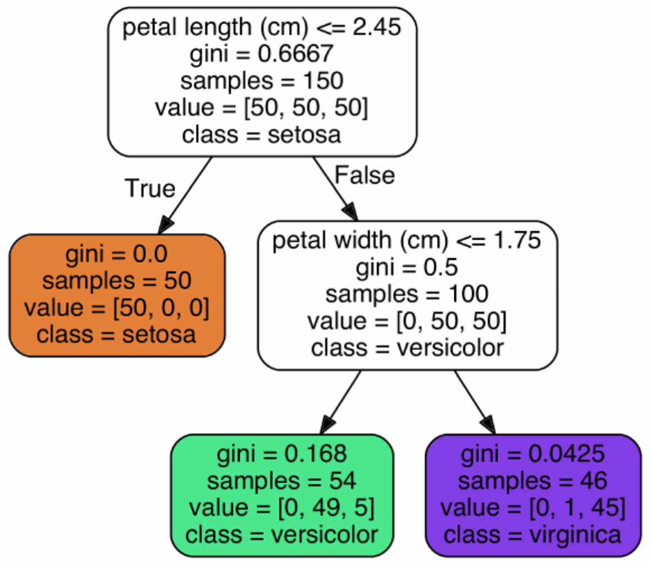
Tree Structure – SciKit version
Iris data set: (multiclass)
Root node
# of obs. in each class:
[Setosa, versicolor, virginica]
Split variable (and condition)
Gini “impurity” index =
1 – [(0/46)² + (1/46)² + (45/46)²]= 0.0425
Leaf node
(terminal node)
Classification

Slide 40
Tree Structure – SciKit version
Class probabilities:
# of obs. in each class:
[Setosa, versicolor, virginica]
Setosa probability: 0%
Versicolor probability: 91%
Virginica probability: 9%

Slide 41
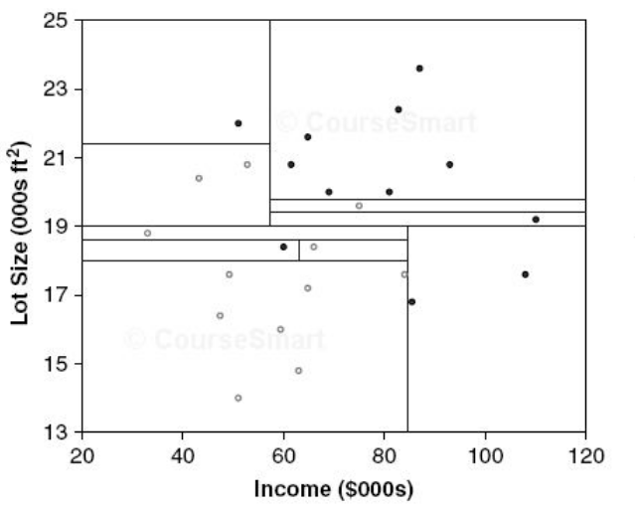
Overfitting
Too many splits cause overfitting:
Overfitting
Fewer splits?
versus

Slide 42
How to Avoid Overfitting
“Regularization” (restrictions) using hyperparameters:
Max_depth: how far can the tree go (default is unlimited)
Min_samples_split: min # of obs. a node must have before a split
Min_samples_leaf: min # of obs. a leaf node must have
Min_weight_fraction_leaf: fraction of min_samples_leaf
Max_leaf_nodes: max # of leaf nodes
Max_features: max # of features examined at each node

Slide 43
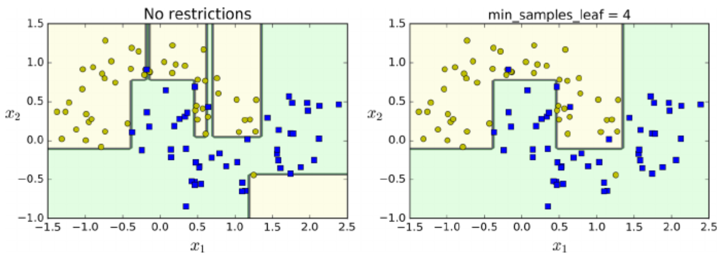
Regularization

Slide 44
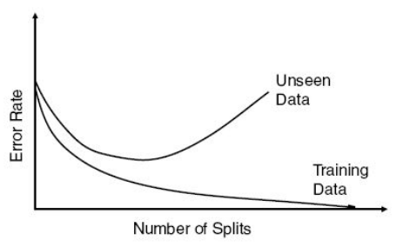
Avoid Overfitting
Write code in Python:
Tree size | Training error rate | Validation error rate
… | … | …
9 | 2.2 | 1.67
10 | 1.6 | 1.67
11 | 1.2 | 1.47
12 | 1.2 | 1.60
13 | 1.2 | 1.60
14 | 1.16 | 1.70
… | … | …
Optimal size
(validation data)

Slide 45
Decision Trees - Regression
Target variable is continuous
Procedure is the same:
Create splits
Instead of "impurity", minimize mean squared error
Take the "average" of the target variable in the leaf node
Disadvantage of Regression Trees: they generate the same value for each observation at the leaf node!

Slide 46
Prediction Decision Tree – Example
Example: (Consider this the TRAIN set)
Value of Mower
$4,000
$3,000
$2,500
$1,500
$4,500
$5,200
Two predictors
(two dimensions)
Target variable
(price of mower)

Slide 47
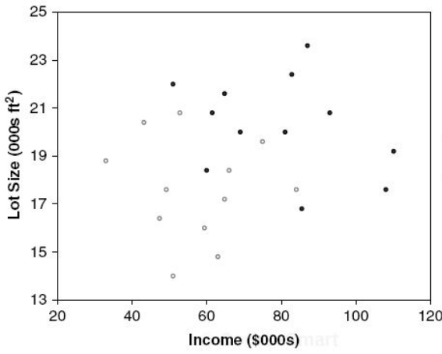
Prediction Decision Tree – Example
Example:
Ave=$6,240
$1,200
Lot size
≤19
>19
$1,500
$1,000
Ave=…
Ave=…
$3,000
Income
$11,000
$3,500
≤84.75
>84.75
$10,000
$12,000
Ave=…
Ave=$3,250

Slide 48
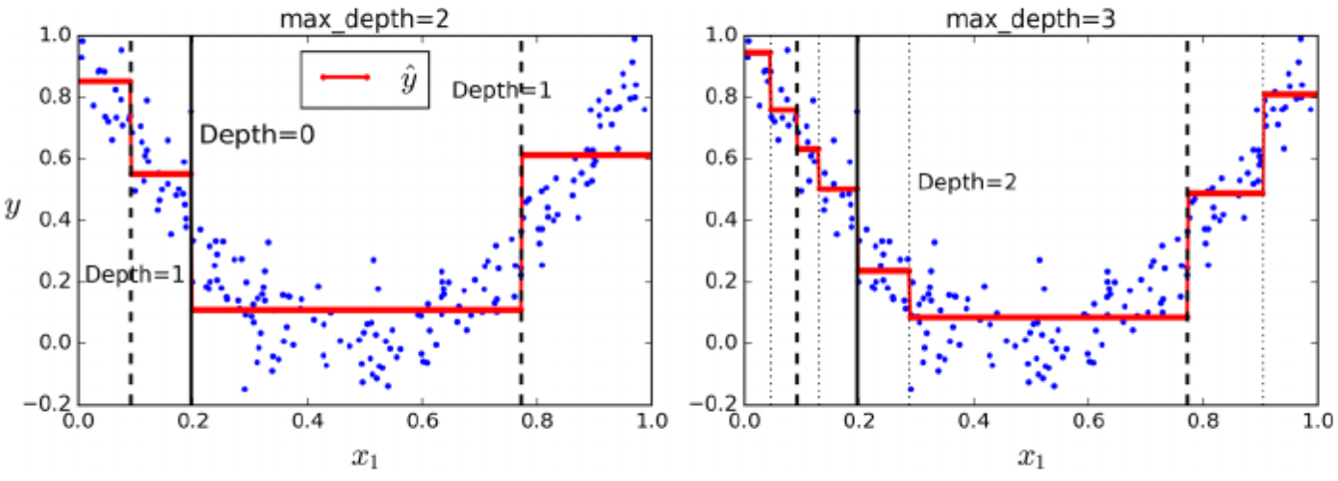
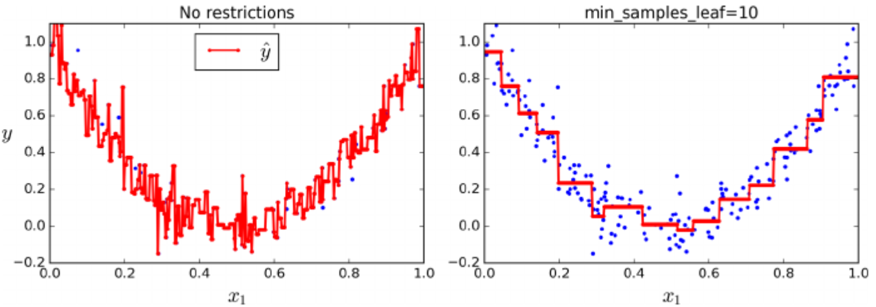
Can Fit Non-linear Models

Slide 49
Advantages of Trees
Accurate and good prediction
Very easy to use
Creates understandable rules (white box)
Can be used for variable reduction (choose only the variables used for splits)
Performs variable selection automatically
Not sensitive to outliers
Can detect various non-linear relationships
Can handle missing values

Slide 50
Disadvantages of Trees
Uses only horizontal or vertical lines. Cannot use diagonal lines.
Requires large data sets
Can be computationally expensive
Susceptible to overfitting!!!
But we have ways of addressing this!

